Slide 1
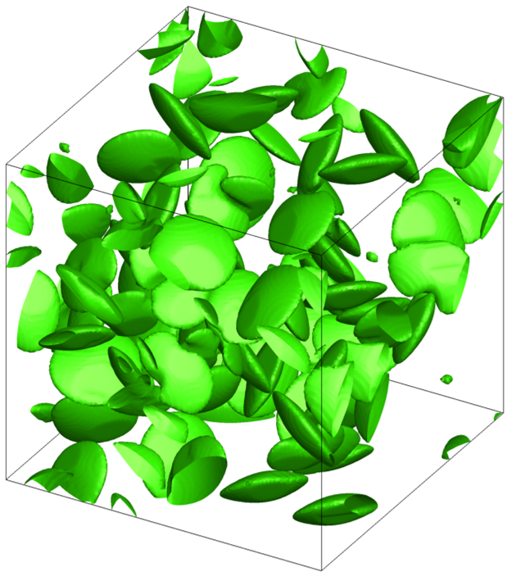
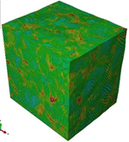
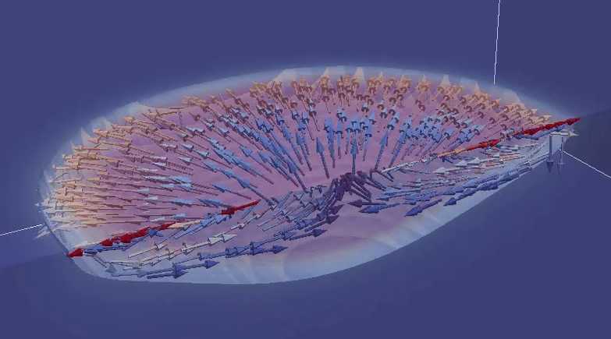
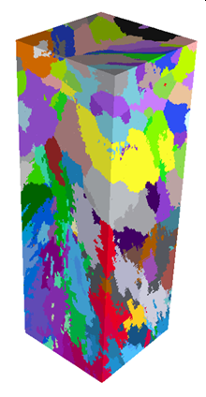
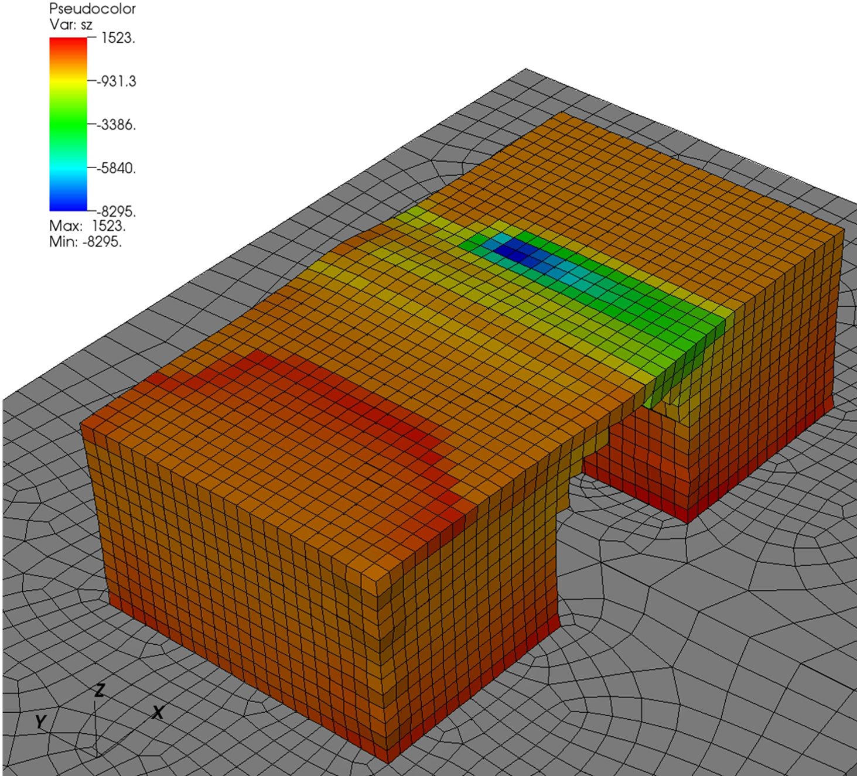
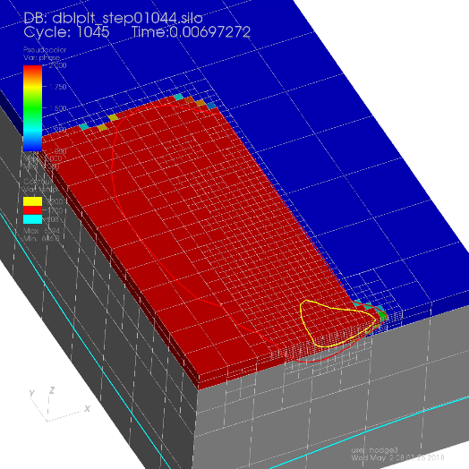
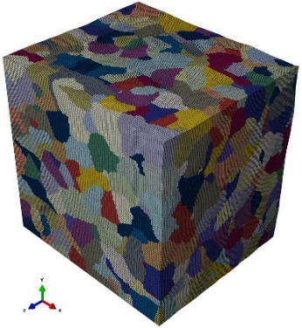
A full ExaAM simulation consists of five stages
0: Full-part build simulation
1: As-built microstructure
2: Late-time Microstructure
3: Micromechanical properties
4: Full-part build simulation
Coarse macroscale thermo-mechanics using assumed properties
Thermomechanics
Solid-solid phase transformation and other mesoscale phenomena during cooling
Response of microstructure to forces, synthesis of macroscale constitutive models from microscale properties
Macroscale thermo-mechanics using improved constitutive properties
Temperatures
Displacements
Coupled CFD
Latent heat, phase fractions
Temperatures
Grain-scale microstructure
Notes:
no single code has all the relevant physics
integrate existing codes with required physics and numerics into extensible software environment
APIs to allow for integration of other components (e.g. reduced-order)
able to be embedded in optimization and deep learning loops
be as unconstrained as possible by computational resource limitations
remove most significant approximations / assumptions
emphasis on tighter coupling of both physics and length scales

Slide 2
No single code has all the required physics ExaAM is leveraging and extending existing codes as well as developing new capabilities
0: Full-part build simulation
1: As-built microstructure
2: Late-time Microstructure
3: Micromechanical properties
4: Full-part build simulation
Diablo
Diablo
MEUMAPPS-SS
ExaConstit
Diablo
Temperatures
Displacements
TruchasPBF
Latent heat, phase fractions
Temperatures
ExaCA
 | TruchasPBF | ExaCA | MEUMAPPS-SS | ExaConstit | Diablo
Physical / Numerical Models | free-surface flow, heat trans., phase change, species diff. | cellular automata, grain growth | phase-field, solid-solid phase transformation | polycrystal plasticity | solid mechanics, heat & mass trans, contact, implicit
Computational Motifs | Eulerian FVM, structured grids, AMR, implicit mimetic finite difference, sparse linear algebra, nonlinear solvers | FDM, structured grids, AMR | Fourier spectral method, structured grids | Lagrangian FEM, unstructured grids, nonlinear mechanics | Lagrangian FEM, unstructured grids, adaptive h-refinement, nonlinear physics, staggered & monolithic solvers
Prog. Lang. (Model) | Fortran (MPI, OpenMP) | C++ (MPI, OpenMP) | Fortran (MPI, OpenMP) | C++ (MPI, CUDA) | Fortran (MPI)
Dependences | Hypre, AMReX | AMReX | P3DFFT | MFEM, Hypre, Metis, SuperLU | Hypre, HDF5, Metis, Silo
Notes:
no single code has all the relevant physics
integrate existing codes with required physics and numerics into extensible software environment
APIs to allow for integration of other components (e.g. reduced-order)
able to be embedded in optimization and deep learning loops
be as unconstrained as possible by computational resource limitations
remove most significant approximations / assumptions
emphasis on tighter coupling of both physics and length scales

